Slide 1
Journey Scrapbook
Akshat Gupta
Batch-6

Slide 2
Foundational Training Week - 2
21-Aug-2023 to 25-Aug-2023

Slide 3
Day 1
Azure DevOps
Epic, User Story, Task and Sub-Task
Sprint Board
Product/Sprint Backlog
Scrum fundamentals
Reports – Burndown, Burnup & Velocity Chart

Slide 4
Day 2
DBMS Definitions
SQL
Normalization – 5 types
Creating a database in postgresql
Joins Overview – CROSS JOIN, OUTER JOIN, GROUP BY

Slide 5
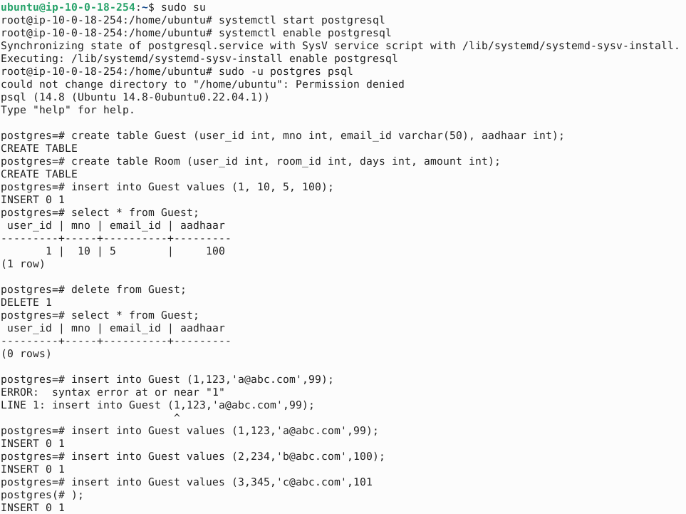
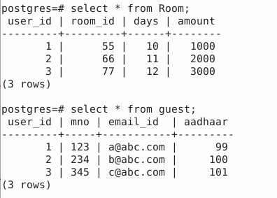

Slide 6
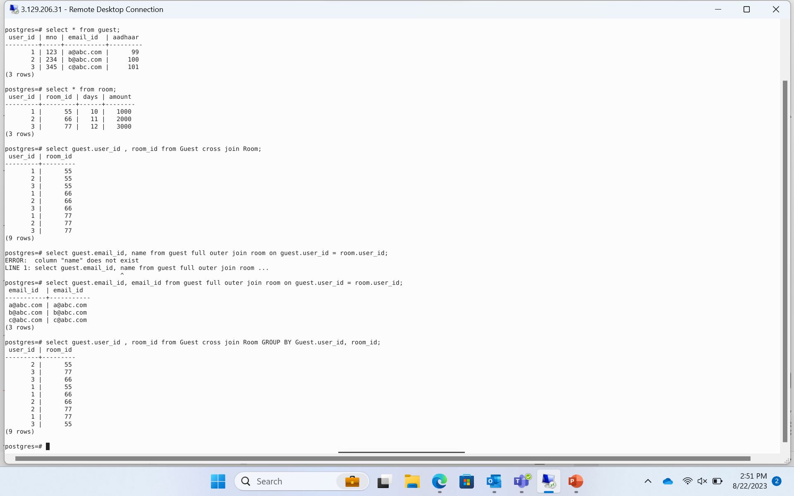

Slide 7
Day 3
Software Testing
Static Testing & Dynamic Testing
Agile methodology
Types of testing, software testing hierarchy.
Different testing techniques namely
-white box testing
-black box testing
-positive and negative testing
-boundary value analysis testing

Slide 8
Software testing was discussed in detail
Discussed about automation testing
Unit testing was explained
Introduction to Fitnesse application
MCQ test on BA, Agile and RDBMS

Slide 9
Day 4
DevOps
Brief of entire development and maintenance process
Introduction to DevOps and Pipelines
Continuous Integration(CI)/Continuous Deployment(CD)
Introduction to GitHub
Understanding the Workflow action in GitHub

Slide 10
Introduction to GitHub workflow, action, events, triggers, dev, main and feature branches
GitHub Commands like
-git pull
-git checkout
-git push
-git status
-git commit

Slide 11
Day 5
Cloud Computing
Creating Virtual machine
Introduction to Cloud
Introduction to Azure
Concepts related to ISP/CSP
Detailed comparison between Microsoft Azure, Google GCP and Amazon AWS

Slide 12
Thank you
Akshat Gupta
Akshat.gupta2@shell.com

